Slide 1
Applying UML in
The Unified Process
Ivar Jacobson
Rational Software email: ivar @rational.com

Slide 2
Before the UML
1960’s - 70’s
  COBOL, FORTRAN, C
  Structured analysis and design techniques
1980’s - early 1990’s
  Smalltalk, Ada, C++, Visual Basic
  Early generation OO methods
Mid/late 1990’s
  Java
  UML
  Unified Process

Slide 3
Models and Diagrams
A model is a complete
description of a system
from a particular
perspective
State
Diagrams
State
Diagrams
Class
Diagrams
Use Case
Diagrams
Use Case
Diagrams
State
Diagrams
Use Case
Diagrams
Use Case
Diagrams
State
Diagrams
Use Case
Diagrams
Object
Diagrams
Sequence
Diagrams
Scenario
Diagrams
State
Diagrams
Scenario
Diagrams
State
Diagrams
Collaboration
Diagrams
Component
Diagrams
Models
Scenario
Diagrams
Component
Diagrams
Scenario
Diagrams
Component
Diagrams
Statechart
Diagrams
Deployment
Diagrams
Activity
Diagrams

Slide 4


But, the UML Is Not Enough
Team-Based
Development
Modeling
Language
Unified
Process

Slide 5
Creating the Unified Process
Rational Unified Process 5.0
Functional testing
Performance testing
Requirements mgmt
Conf. and change mgmt
Business engineering
Data engineering
UI design
1998
Rational
Objectory Process 4.1
1996-1997
The Rational Approach
UML
Objectory Process 1.0-3.8
1987-1995
The
Ericsson Approach

Slide 6
What Is a Process?
Defines Who is doing What, When to do it, and How to reach a certain goal.
New or changed
requirements
New or changed
system
Software Engineering
Process

Slide 7
Overview of the Unified Process
The Unified Process is
  Iterative and incremental
  Use case driven
  Architecture-centric

Slide 8
Lifecycle Phases
Inception
Elaboration
Construction
Transition
time
Inception Define the scope of the project and develop business case
Elaboration Plan project, specify features, and baseline the architecture
Construction Build the product
Transition Transition the product to its users

Slide 9
Major Milestones
Inception
Elaboration
Construction
Transition
time
Vision
Baseline
Architecture
Initial
Capability
Product
Release

Slide 10
Phases and Iterations
Inception
Elaboration
Construction
Transition
Prelim
Iteration
...
Arch
Iteration
...
Dev
Iteration
Dev
Iteration
...
Trans
Iteration
...
Release
Release
Release
Release
Release
Release
Release
Release
An iteration is a sequence of activities with an established plan and evaluation criteria, resulting in an executable release

Slide 11
Iterations and Workflow
P
h
a
s
e
s
C
o
r
e
W
o
r
k
f
l
o
w
s
I
n
c
e
p
t
i
o
n
E
l
a
b
o
r
a
t
i
o
n
C
o
n
s
t
r
u
c
t
i
o
n
T
r
a
n
s
i
t
i
o
n
Requirements
A
n
i
t
e
r
a
t
i
o
n
i
n
t
h
e
e
l
a
b
o
r
a
t
i
o
n
p
h
a
s
e
Analysis
Design
Implementation
Test
P
r
e
l
i
m
i
n
a
r
y
i
t
e
r
.
i
t
e
r
.
i
t
e
r
.
i
t
e
r
.
i
t
e
r
.
i
t
e
r
.
i
t
e
r
.
I
t
e
r
a
t
i
o
n
(
s
)
#
1
#
2
#
n
#
n
+
1
#
n
+
2
#
m
#
m
+
1
I
t
e
r
a
t
i
o
n
s

Slide 12
Workflows and Models
UML diagrams provide views into each model
Requirements
Use Case
Model
Analysis
Analysis
Model
Design
Design
Depl.
Model
Model
Implementation
Impl.
Model
Test
Test
Model
Each workflow is associated with one or more models.

Slide 13
Use Case Model
Use Case
Diagrams
Use Case
Model
Class
Diagrams
Object
Diagrams
Analysis
Component
Diagrams
Model
Design
Deployment
Diagrams
Model
Sequence
Diagrams
Depl.
Model
Collaboration
Diagrams
Impl.
Model
Statechart
Diagrams
Test
Model
Activity
Diagrams

Slide 14
Analysis & Design Model
Use Case
Diagrams
Use Case
Model
Class
Diagrams
Object
Diagrams
Analysis
Component
Diagrams
Model
Incl. subsystems and packages
Design
Deployment
Diagrams
Model
Sequence
Diagrams
Depl.
Model
Collaboration
Diagrams
Impl.
Model
Statechart
Diagrams
Test
Model
Activity
Diagrams

Slide 15
Deployment and Implementation Model
Use Case
Diagrams
Use Case
Model
Class
Diagrams
Object
Diagrams
Analysis
Component
Diagrams
Model
Design
Deployment
Diagrams
Model
Incl. active classes and components
Sequence
Diagrams
Depl.
Model
Collaboration
Diagrams
Impl.
Model
Statechart
Diagrams
Test
Model
Activity
Diagrams

Slide 16
Test Model
Use Case
Diagrams
Use Case
Model
Class
Diagrams
Object
Diagrams
Analysis
Component
Diagrams
Model
Design
Deployment
Diagrams
Model
Test model refers to all other models and uses corresponding diagrams
Sequence
Diagrams
Depl.
Model
Collaboration
Diagrams
Impl.
Model
Statechart
Diagrams
Test
Model
Activity
Diagrams

Slide 17
Use Case Driven
Req.ts
Analysis
Design
Impl.
Test
Use Cases bind these workflows together

Slide 18
Use Cases Drive Iterations
Drive a number of development activities
  Creation and validation of the system’s architecture
  Definition of test cases and procedures
  Planning of iterations
  Creation of user documentation
  Deployment of system
Synchronize the content of different models

Slide 19
Architecture-Centric
Models are vehicles for visualizing, specifying, constructing, and documenting architecture
The Unified Process prescribes the successive refinement of an executable architecture
Inception
Elaboration
Construction
Transition
time
Architecture

Slide 20
Architecture and Models
Use Case
Analysis
Design
Depl.
Impl.
Test
Model
Model
Model
Model
Model
Model
Models
Views
  Architecture embodies a collection of views of the models

Slide 21
Function versus Form
Use cases
Architecture
  Use case specify function; architecture specifies form
  Use cases and architecture must be balanced

Slide 22

The Unified Process is Engineered
A unit of work
A role played by an individual or a team
Activity
Worker
Analyst
Describe a
Use Case
responsible for
Artifact
A piece of information that is produced, modified, or used by a process
Use case
Use case
package

Slide 23
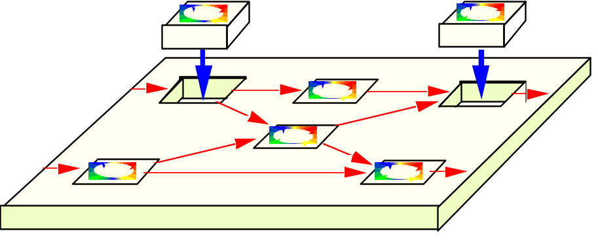
The Unified Process is a Process Framework
There is NO Universal Process!
The Unified Process is designed for flexibility and extensibility
  allows a variety of lifecycle strategies
  selects what artifacts to produce
  defines activities and workers
  models concepts

Slide 24

Two Parts of a Unified Whole
The Unified
Modeling
Language
The Unified
Process
OMG standard
Convergence in the future
Convergence through process frameworks

